Slide 1
How Can Fathers Be Good Leaders?
Gaining Good Homes!
Part 1
All verses are from the New King James Version
Notes:
We live in a society where the father is downplayed. In many homes he is absent and in several homes where he is present, he provides very little by way of what is good. Dead beat dads, lazy men, self-centered males are destructive to the home and are trouble to society. Boys need to grow up into men. One of the reasons that this country is in the state that it currently is, is because of a lack in male leadership.

Slide 2
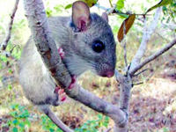
Key Largo
Woodrat
Emphasized Today
ENDANGERED SPECIES!
Godly Families
Deemphasized Today
Notes:
Homes like those portrayed in “Father knows best,” “Leave it to Beaver,” and “The Cosby Show” are no longer acceptable to Hollywood and are harder to find in America. This kind of family should be first and foremost on the endangered list today but it won’t be spoken in any endangered species discussion.
Instead we focus our energies on saving rodents like the Key Largo Woodrat, “…This small endemic rodent once ranged throughout all of Key Largo, but today is limited to the northernmost portions” (http://www.fws.gov/endangered/map/state/FL.html)

Slide 3
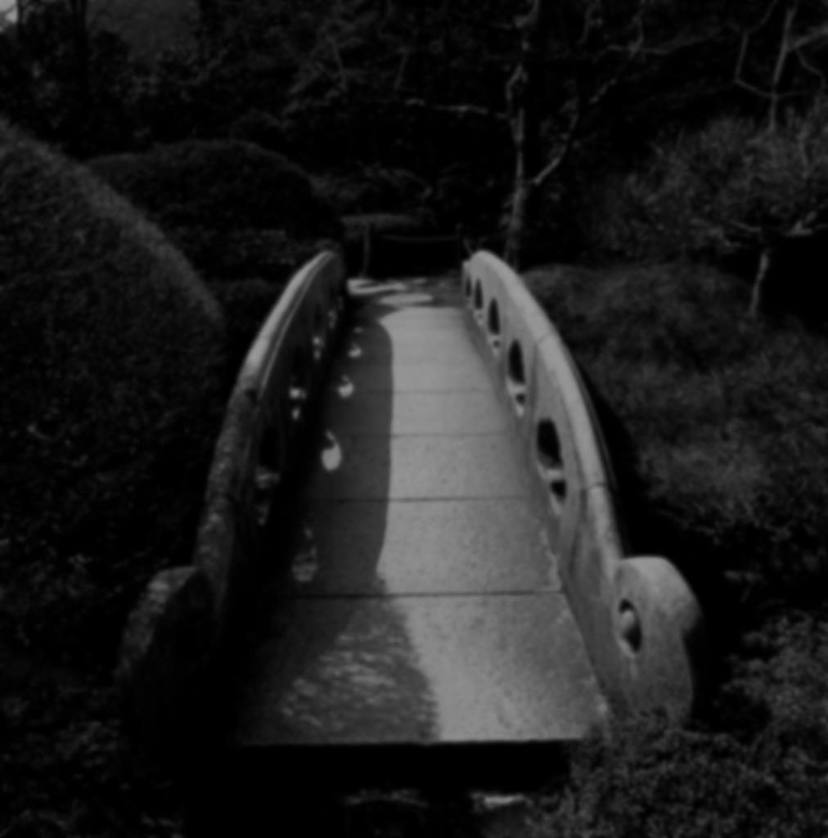
Male Leadership Deficit
“They are bridges to the future. Nations that are populated largely by immature, immoral, weak-willed, cowardly, and self-indulgent men cannot and will not long endure. These types of men include those who sire and abandon their children; who cheat on their wives; who lie, steal, and covet; who hate their countrymen; and who serve not God but money” (James Dobson)

Slide 4
“So I sought for a man among them who would make a wall, and stand in the gap before Me on behalf of the land, that I should not destroy it; but I found no one” (Ezek. 22:30)
?
Notes:
How can a society deteriorate to where “a man” who can stand in the gap is not only an endangered species, but is altogether extinct? What did Jehovah find when He scanned the human landscape of Israel? He found prophets who were like a lion tearing prey. They perpetuated falsehoods in the name of God. He also found priests who were profane and could not distinguish between holy and unholy things. When Jehovah looked at the rulers, He saw much of the same —men as wolves, tearing their prey to get personal gain. When He looked at people, He saw oppressors, robbers, as well as a people who abused the poor (Ezek. 22:23-29).
Jehovah found all kinds of sin and sinners, but could not find a real man in the prophets, priests, rulers, or the populace. How could this be? Fundamentally, godly men became extinct because men at one point, whether gradual or rapid, had stopped leading their children in paths of righteousness; righteousness continued to shrink away from the people and sin, like a cancerous tumor, continued to grow.
This was a society devoid of any leader of righteousness, there was not a Moses, not a Joshua, not a David, not a Samuel, not a Daniel that could lead and influence the people for good. Rather it was a society laden with lust, ravaged with savage appetites, broken with infidelity, overflowing with idolatry and adultery; a society full of drunken beasts who pursued what was unlawful.
This was Jeremiah’s complaint against the people (see Jer. 5:1-9). I wish the men of America would wake up to this point. If you are not going to lead in righteousness, then you are going to follow and pursue unrighteousness. The men who were at this time were stout and organized when it came to filling up houses of harlots, they were strong in steadfast in pursuing their neighbors’ wives, but that robust quality could not be tamed and trained in righteousness. Where did it lead them? Into being rejected by their Creator and buried in a Babylonian grave of captivity and oppression.

Slide 5
Our Children Will Inherit What We Leave:
our world
our positions
our name
our reputation
our pursuits
Notes:
Ecclesiastes 2:18, 19. Everything we have, every position of authority, every skill and trade on this planet will be turned over to the next generation.

Slide 6
Through A Glorious Example
“Children’s children are the crown of old men, And the glory of children is their father” (Prov. 17:6)
Fathers Can Be Good Leaders

Slide 7
The Father-glory of children
Man designed to be the glory of God (1 Cor. 11:7)
Should reflect the Father in heaven to children
Children should honor that position and example (Mal. 1:6)
Notes:
He is to be the representative of God to the children. Men should ask themselves, what kind of picture of “The Father” are we putting in the minds of our children when we pray, “Our Father in heaven?” How do I model the Father? How can I provide the example of the Father?

Slide 8
1. Leading In A Work-Ethic
“He who gathers in summer is a wise son; He who sleeps in harvest is a son who causes shame” (Prov. 10:5)
“Whatever your hand finds to do, do it with your might. . .” (Eccl. 9:10)
Built within us the ability to “rule” and “tend” (Gen. 1:28, 2:15)
Notes:
I can be a leader of my family by my work-ethic.
I’ll talk more about “rule” and “tend” next week.

Slide 9
Burdened In Youth
“The LORD is good to those who wait for Him, To the soul who seeks Him. It is good that one should hope and wait quietly For the salvation of the LORD. It is good for a man to bear the yoke in his youth. Let him sit alone and keep silent, Because God has laid it on him; Let him put his mouth in the dust—There may yet be hope” (Lam. 3:27-29)
Notes:
Sandwiched between hope is this idea of bearing the yoke. As an aid to waiting and seeking the Lord is the idea of bearing the yoke in the youth.
It is natural for parents to want to shield their children from pain and coddle them. Parents who provide everything for their children when their children are capable of providing things for themselves are only stifling growth and hindering their children from reaching their potential in life. Life is real and it only rewards those who endure and patiently persevere (Prov. 13:4).
We see a connection here with patiently waiting on the Lord and one learning to silently endure the yoke of life while young. If he can learn to endure hardship, pain, responsibility and accountability while young, then there is hope that he will also endure when he is old and not grow faint in service to God when the more difficult days come. What will they do in life’s earthquakes who have only lived on easy street? In a parallel thought see Rom. 5:3, 4.

Slide 10
1 Timothy 5:8
“But if anyone does not provide for his own, and especially for those of his household, he has denied the faith and is worse than an unbeliever”
Notes:
Christianity and laziness are incompatible, see 2 Thess. 3:10. God provided the blessing for us through His own suffering, hence the passion of Christ. A man who fails to provide for his own is worse than an unbeliever. He not only rejects God’s word, but he rejects God’s own example.

Slide 11
2. Leading In Education
Parents are responsible for the kind of education their children receive
Sensible
Spiritual
Notes:
Make no mistake; the education which our children receive is something which we are going to be held accountable for. We should be actively engaged with what our children are learning as such will either bring joy or grief in later years.
The Scriptures teach that both parents should be actively involved in training their children; God, however, places the oversight and accountability of it on the father. “The living, the living man, he shall praise You, As I do this day; The father shall make known Your truth to the children” (Is. 38:19; cf. Ps. 78:3-8; Eph. 6:4; etc.).

Slide 12
Where Fathers Can Lead In Education
Danger of peer pressure (Prov. 1:10ff)
Seeking the wisdom of God (Prov. 2:1-9)
Honoring the Lord (Prov. 3:1-12)
Advice in avoiding human traps (Prov. 2:10-19)
Avoiding immoral men and women
Marrying a good spouse (Pr. 18:22; 31:10-31)
Notes:
Proverbs is a book of fatherly advice to children. It makes a good manual of instruction for fathers to use today.
PEER PRESSURE: The father needs to demonstrate with his actions and his words as one who does not bow to peer pressure. He should display such an example in his decision making.
AVOIDING HUMAN TRAPS: The Father should provide an example of one who pursues the wisdom of God and educate his children against crooked men and immoral women. His sons need to know that if you run to an immoral woman, you are running to your death (2:18, 19). Proverbs gives good advice in finding a godly spouse for both men and women. I have a sermon on wisdom in selecting a spouse from the book of Proverbs. (Prov. 12:10 shows the character of a man).
The Bible is not just a book that identifies problems, but is also a book of problem solving. Avoiding the evil is a huge part of scripture. But so is pursuing what is good. Marriage is a good thing. An excellent wife is a good thing (Prov. 12:4). The Bible also displays the right kind of woman to marry (Prov. 19:14). She is called the “virtuous wife, that is a woman of valor with manifold excellence. The success of her husband is due in a large part from her. Read 31:10-12, 23-31.

Slide 13
Where Fathers Can Lead In Education
Calm during terror (Prov. 3:25, 26)
Sound business practices (Prov. 3:27, 28; 10:4; 20:17)
Sound sexual advice (Prov. 5:15-23)
Danger of envy (Prov. 3:31ff)
Danger of debt (Prov. 6:1-5; 22:7; 2 Kin. 4:1)

Slide 14
Will I Lead In Righteousness?
Must first be willing to “follow” Jesus Christ our Righteous (Matt. 16:24)
“In His days Judah will be saved, And Israel will dwell safely; Now this is His name by which He will be called: THE LORD OUR RIGHTEOUSNESS” (Jer. 23:6)

Slide 15
Will I Lead In Righteousness?
Must first be willing to “follow” Jesus Christ our Righteous (Matt. 16:24)
Jeremiah 23:6
“But of Him you are in Christ Jesus, who became for us wisdom from God—and righteousness and sanctification and redemption—that, as it is written, ‘He who glories, let him glory in the LORD’” (1 Cor. 1:30, 31)
Notes:
Must be in Christ to be righteous.

Slide 16
Will I Lead In Righteousness?
Must first be willing to “follow” Jesus Christ our Righteous (Matt. 16:24)
Jeremiah 23:6
Are “you are in Christ Jesus” (1 Cor. 1:30, 31)
“Then Crispus, the ruler of the synagogue, believed on the Lord with all his household. And many of the Corinthians, hearing, believed and were baptized” (Acts 18:8)
“For as many of you as were baptized into Christ have put on Christ” (Gal. 3:27)
Notes:
Must be in Christ to be righteous.

Slide 17
Will I Lead In Righteousness?
Must first be willing to “follow” Jesus Christ our Righteous (Matt. 16:24)
Jeremiah 23:6
1 Corinthians 1:30, 31
“My little children, these things I write to you, so that you may not sin. And if anyone sins, we have an Advocate with the Father, Jesus Christ the righteous. And He Himself is the propitiation for our sins, and not for ours only but also for the whole world” (1 Jn. 2:1, 2)
Notes:
John reminds Christians that if we sin, we also have an advocate, Jesus Christ the Righteous. We can confess our sins to him and be forgiven pending we are willing to repent.

